Slide 2
Health Equity Matters Housing and Homelessness
October 2019
Saralyn Semeniuk
Health Promoter
Notes:
This presentation on housing and homelessness is the 5th of 7 modules developed to increase staff knowledge about the topics highlighted in the Health Equity Matters campaign.

Slide 3
Outline
Health equity and the SDOH
Housing, homelessness and health
What is homelessness?
What causes homelessness?
Who is homeless?
Can homelessness be prevented?
Current supports and strategies
Notes:
During this presentation, we’ll do a brief review of the Social Determinants of Health and Health Equity.
And we’ll look at the effects that housing and homelessness can have on health.
Definitions of homelessness will be presented, and we’ll review the causes, the people who are most affected and how homelessness can be prevented. We’ll also look at some of the actions currently being taken to address homelessness, and reduce the negative impacts.

Slide 4
Health Equity and SDOH
Health equity exists when everyone has a fair chance to achieve their best health
This means that everyone has equal access or opportunity to the SDOH
Notes:
Health equity means that all people can reach their full health potential and are not disadvantaged from attaining it because of their race, ethnicity, religion, gender, age, social class, socioeconomic status or other socially determined circumstance.

Slide 5
Notes:
We can help to ‘level the playing field’ by approaching things with a health equity lens and giving people what they need to achieve optimal health.
Which isn’t necessarily the same as equality – or giving all people the same thing.

Slide 6
Social determinants of health (short list)
Income and social status
Social support networks
Education and literacy
Employment/working conditions
Healthy child development
Food insecurity
Housing
Access to heath care
Gender
Culture
Language
Disability
Notes:
The social determinants of health are the social and economic factors that influence the health of a population. Housing is included as one of these factors.
This list shows some of the common factors referred to as social determinants of health, but there are many more. And these factors overlap and cluster into groups of disadvantage and marginalization for individuals and populations.

Slide 7
Housing, homelessness and health
Poor quality housing is linked to higher rates of:
Disease, illness and injury
Poor nutrition
Poor mental health
Stress and anxiety
Exposure to violence
Notes:
Access to safe, stable, affordable housing is linked to better health.
Affordable housing leaves people with more money to spend on basic needs such as healthy food, clothing, medicine, child care and transportation.
These benefits lead to better emotional and mental health, more stability and less stress.
Having a safe, secure, well-located place to live is an important part of gaining employment, food security, access to social services, education, recreation and health care.

Slide 8
What is homelessness?
Canadian Definition of Homelessness:
“The situation of an individual, family, or community without stable, safe, permanent, appropriate housing, or the immediate prospect, means and ability of acquiring it.”
(Canadian Observatory on Homelessness, 2017)
Notes:
According to the Canadian Definition of Homelessness, homelessness is “the situation of an individual, family, or community without stable, safe, permanent, appropriate housing, or the immediate prospect, means and ability of acquiring it.”
It is important to note that this definition does not fully encompass every experience of homelessness. There are groups of people who are affected differently, and every individual’s experience is unique. Homelessness is not strictly an issue of housing instability. These are all important considerations when determining methods of addressing homelessness, as one strategy does not apply for every community.

Slide 9
What is homelessness?
Definition of Indigenous Homelessness:
“a human condition that describes First Nations, Métis and Inuit individuals, families or communities lacking stable, permanent, appropriate housing, or the immediate prospect, means or ability to acquire such housing…Indigenous homelessness is not defined as lacking a structure of habitation; rather, it is more fully described and understood through a composite lens of Indigenous worldviews.”
(Aboriginal Standing Committee on Housing and
Homelessness, 2012)
Notes:
The Indigenous definition of homelessness considers the traumas imposed on Indigenous Peoples through colonialism. According to the Definition of Indigenous Homelessness in Canada, it is “a human condition that describes First Nations, Métis and Inuit individuals, families or communities lacking stable, permanent, appropriate housing, or the immediate prospect, means or ability to acquire such housing.
Indigenous homelessness is not defined as lacking a structure of habitation; rather, it is more fully described and understood through a composite lens of Indigenous worldviews.”
These include: individuals, families and communities isolated from their relationships to land, water, place, family, kin, each other, animals, cultures, languages and identities.
Importantly, Indigenous people experiencing these kinds of homelessness cannot culturally, spiritually, emotionally or physically reconnect with their Indigeneity or lost relationships.

Slide 10
What is homelessness?
Canadian Definition of Youth Homelessness:
“A situation and experience of young people between the ages of 13-24 who are living independently of parents and/or caregivers, but do not have the means or ability to acquire stable, safe or consistent residence.”
(Canadian Observatory on Homelessness, 2016)
Notes:
Youth experience homelessness in fundamentally different ways than adults, due to their age. The Canadian Definition of Youth Homelessness outlines that it is a “situation and experience of young people between the ages of 13-24 who are living independently of parents and/or caregivers, but do not have the means or ability to acquire stable, safe or consistent residence.”
Youth homelessness is a complex social issue and a denial of basic human rights.
In addition to experiencing economic deprivation and a lack of secure housing, many young people who are homeless lack the personal experience of living independently and at the same time may be in the throes of significant social, physical, emotional and cognitive developmental changes. As a result, they may not have the resources, resilience, education, social supports or life skills necessary to foster a safe and nurturing transition to adulthood and independence. Few young people choose to be homeless, nor wish to be defined by their homelessness, and the experience is generally negative and stressful.

Slide 11
What causes homelessness?
The causes of homelessness are often a complex interplay between:
Structural factors
System failures
Poverty
Individual circumstances
Notes:
Homelessness is usually the result of the cumulative impact of a number of factors, rather than a single cause.
The causes of homelessness are a complex interplay between structural factors, systems failures, poverty and individual circumstances.
Structural factors are economic and societal issues that affect opportunities, environments, and outcomes for individuals. This includes poverty, discrimination, lack of affordable housing, and the impact of colonialism on Indigenous Peoples.
Systems failures occur when other systems of care and support fail, requiring vulnerable people to turn to the homelessness sector, when other mainstream services could have prevented this need. Examples of systems failures include difficult transitions from child welfare, inadequate discharge planning for people leaving hospitals, and corrections and mental health and addictions facilities.
Personal circumstances of those experiencing homelessness may include: traumatic events like a house fire or job loss, personal crisis such as a family break-up or domestic violence, mental health and addictions challenges, physical health problems or disabilities, and extreme poverty.

Slide 12
Who is homeless?
Those at greater risk for homelessness include:
Indigenous people
Those with mental illness
Low-income families
Notes:
Indigenous people, those with mental illness and low-income families with children are at greater risk for homelessness, and more likely to live in unsafe, unstable, and unaffordable housing.
The possibility of homelessness has harmful effects on children, and homelessness has lasting impacts on mental and physical health that can lead to illness later in life.

Slide 13
Who is homeless?
In the Northwestern Health Unit Catchment Area:
17% of households spend 30% or more of their income on shelter costs
15.8% of dwellings in need of major repairs—the average for Ontario is 6.1%
6.4% of dwellings are considered not suitable for living—the average for Ontario is 6.0%
(Source: 2016 Census)
Notes:
In the Northwestern Health Unit Catchment Area
- 17% of households spend 30% or more of their income on shelter costs
- Almost 16% of dwellings are in need of major repairs, while the average for Ontario is 6.1%
- And 6.4% of dwellings are considered not suitable for living.

Slide 14
Who is homeless?
Homelessness Enumeration 2018
NWHU questions – key findings:
504 people experiencing homelessness across the Kenora and Rainy River Districts.
In the Kenora District, 44% of the homeless population say there is not enough room in shelters.
In the Rainy River District, 29.7% do not know where shelters are.
Notes:
In the spring of 2018, Homelessness enumerations took place in the Kenora and Rainy River Districts in the communities of Atikokan, Fort Frances, Dryden, Ignace, Kenora, Lac Seul, Vermilion Bay, Pickle Lake, Red Lake and Sioux Lookout. The Northwestern Health Unit had the opportunity to include some health-related questions in the surveys conducted. Some key findings from the surveys showed that…
- 504 people were experiencing homelessness across the Kenora and Rainy River Districts.
- In the Kenora District, 44% of the homeless population said there is not enough room in shelters.
- And in the Rainy River District, nearly 30% do not know where shelters are.

Slide 15
Who is homeless?
Homelessness Enumeration 2018
NWHU questions – key findings:
37.4% do not know what health or other community services are available to them
54.3% get information about health and community services available to them through word of mouth and 45.3% via other service providers
Notes:
In addition, the results showed that:
- 37.4% do not know what health or other community services are available to them; and
- 54.3% get information about health and community services available to them through word of mouth and 45.3% via other service providers

Slide 16
Who is homeless?
Homelessness Enumeration 2018
NWHU questions – key findings:
39.6% of the homeless population has access to a mobile device.
70.3% of the homeless population uses social media; and
of that population, 97.9% use Facebook.
Notes:
It was found that:
- Almost 40% of the homeless population has access to a mobile device;
70.3% uses social media;
and of this population, 97.9% use Facebook.
The results from the enumerations will be useful in planning the work we do with community partners to address homelessness and its resulting negative impacts.

Slide 17
Can homelessness be prevented?
Homelessness prevention requires:
Policies and strategies
Early interventions
Reducing the risk of reoccurrence
Adequate resources
Notes:
Historically, emergency services such as soup kitchens and shelters, have been the dominant response to homelessness. While these services are important in helping meet people’s immediate needs, it does not have the effect of reducing and ending homelessness. In fact, these responses can trap people in homelessness and make it very difficult to become safely and securely housed.
Ultimately, prevention efforts are key in ending homelessness.
Homelessness prevention requires:
-Policies and strategies at the structural and systemic levels that reduce the chances of homelessness
-Early interventions that address individual and situational factors
-Reducing the risk of reoccurrence of homelessness
-Ensuring the resources needed to stabilize housing, integration and social inclusion

Slide 18
Can homelessness be prevented?
Homelessness prevention framework
Structural prevention
Systems prevention
Early intervention
Evictions prevention
Housing stability
Notes:
Homelessness occurs as a result of a combination of structural, systematic, and individual/ relational factors. Addressing the multiple causes of homelessness through a coordinated effort will improve housing stability and reduce the risk of homelessness overall.
Housing, social services, health, and employment sectors all have a role to play in preventing homelessness.
Preventing homelessness cannot and should not be the sole responsibility of the homelessness sector.
Structural prevention includes increasing affordable housing stock, anti-descrimination policy, poverty reduction strategies and income supports.
Systems prevention ensures supports such as transportation, translation, disability and navigation services.
Early intervention can involve family mediation, shelter diversion and case management.
Evictions prevention includes landlord and tenant legislation, rent supplements, emergency funds, and legal advice and representation.
Housing stability is ensured through help obtaining and retaining housing, supports for health and well-being, education, employment, and social inclusion.

Slide 19
Current supports and strategies
Funding
The federal, provincial and municipal governments fund local housing initiatives.
These include affordable units, rent supplements, housing repairs, and ownership grants.
The federal government also contributes to Indigenous housing, on and off reserves.
Notes:
In our region:
The federal, provincial and municipal governments fund local housing initiatives.
These include affordable units, rent supplements, housing repairs, and ownership grants.
The federal government also contributes to Indigenous housing, on and off reserves.

Slide 20
Current supports and strategies
Government spending 2014 – 2018
Group Municipal Prov. Federal
Community Housing 54% 11% 35%
Homelessness 23% 69% 8%
Supportive Housing 0.5% 99% 0.5%
Ontario’s Community Housing Renewal Strategy
https://www.ontario.ca/page/community-housing-renewal-strategy
Notes:
Across all three governments, approximately $5 billion was spent on housing and homelessness services in Ontario in 2017-18.
Municipalities are the biggest contributors to community housing, with support from the federal government and the province.
The province is the primary funder of homelessness services, with some municipalities making a large contribution and some communities receiving federal funding as well.
The province is also the primary funder of supportive housing programs, which combines subsidized housing with support services.
Spending varies from year to year, but overall the province is the largest contributor to housing and homelessness spending in Ontario.

Slide 21
Current supports and strategies
Reaching Home – June 2018
Federal government’s redesigned homelessness strategy
Aims to reduce chronic homelessness by 50% over the next ten years
Part of Canada’s first-ever National Housing Strategy—a 10-year $40-billion plan to address housing need
Notes:
In June 2018, the Government of Canada announced changes to the federal strategy to prevent and reduce homelessness through a redesigned homelessness strategy called Reaching Home. The new strategy is part of the 10 year National Housing Strategy. It aims to double support for communities to address the needs of those experiencing or at risk of homelessness, and reduce homelessness by 50% over the next 10 years.

Slide 22
Current supports and strategies
Community Housing Renewal Strategy
Provincial plan focused on affordable housing for low-income households and the non-profit, co-operative and municipal housing sector
Notes:
At the provincial level, the Community Housing Renewal Strategy is focused on affordable housing for low-income households and the non-profit, co-operative and municipal housing sector.
Community housing provides a home to many people who have difficulty finding housing in the private market. It can provide homes to people working low-income jobs, seniors, those living on social assistance, and individuals with developmental disabilities, mental health and addictions challenges, and people who have experienced homelessness. Community housing also provides priority access to those who have experienced domestic violence and human trafficking.

Slide 23
Prevention – it’s worth it!
Average monthly costs of:
Shelter bed - $1932
Provincial jail - $4333
Hospital bed - $10,900
Compared to average monthly cost of:
Rent supplements - $701
Social housing - $200
(Canadian Observatory on Homelessness – Cost Analysis of Homelessness)
Notes:
The combined supports and strategies provided through all levels of government are critical to addressing local housing and homelessness issues. Homelessness costs the Canadian economy over $7 billion annually.
This includes the provision of emergency shelters and community supports, but also accounts for the increased costs of emergency services, including fire, police and EMS, health care, and the criminal justice system.
This comparison of costs clearly shows that rent supplements and social housing are far more economically efficient than shelters, jails and hospitals.

Slide 24
What can be done?
You can get involved in:
Advocacy work with local housing, income, and poverty groups
Policy development to ensure navigation supports at critical points of transition from systems
Local and regional elections
Notes:
To help address housing issues at the local level, you can get involved in:
Advocacy work with local housing, income, and poverty groups, with an orientation toward collective action to prevent homelessness and make housing more affordable.
Policy development can help to ensure navigation supports are available at critical points of transition from systems such as hospitals, schools, corrections, child protection, and mental health programs.
Local and regional elections also provide an opportunity to vote for parties and candidates whose platforms support more housing options and access to affordable, safe, quality housing.

Slide 25
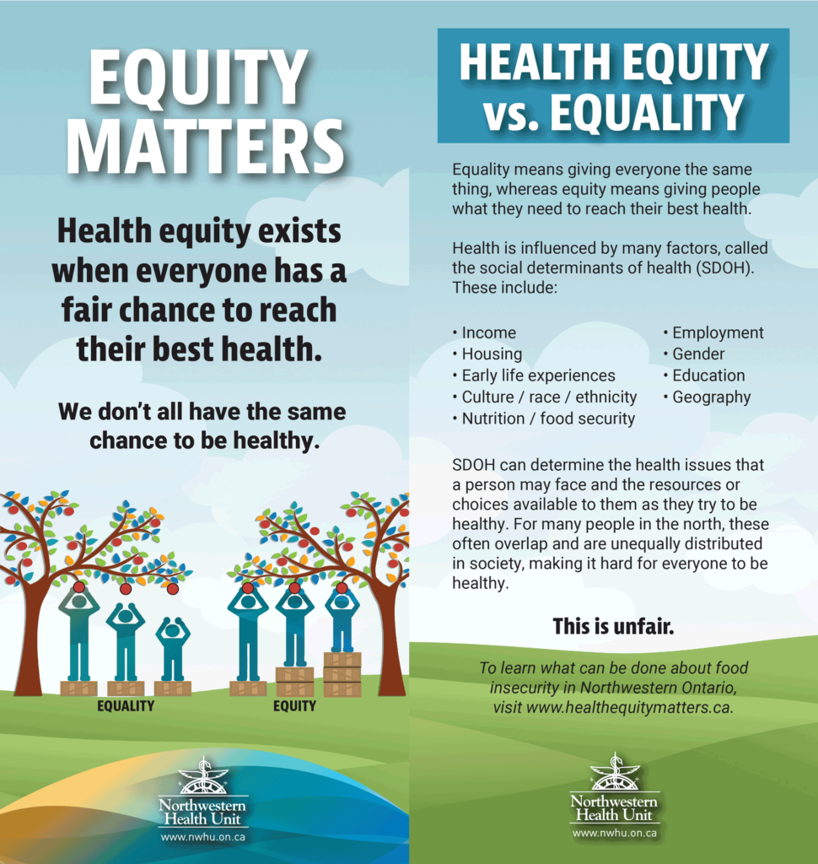
Notes:
In addition, we can increase awareness of the importance of Health Equity among the public and our community partners, which is one of the objectives of our Health Equity Matters campaign.

Slide 26
Role of Public Health
Notes:
‘Housing Matters’ is the 5th of 7 topics we will be highlighting through this campaign.

Slide 27
Role of Public Health
Notes:
Housing Matters messaging will be shared with the public through posters, rack cards, social media, news website banners, radio ads and on the Health Equity Matters website.

Slide 28
Conclusion
“Homelessness impacts everyone. From the costs of emergency shelters, to institutional health and psychiatric services and the criminal justice system, to the individual physical and mental health impact on every homeless person, the causes and effects of homelessness cost all Canadians dearly.”
Gaetz, Stephen (2012): The Real Cost of Homelessness:
Can We Save Money by Doing the Right Thing? Toronto: Canadian Homelessness Research Network Press.
Notes:
In conclusion, we need to share the message that homelessness impacts everyone, and that an affordable, safe, and adequate home is a human right. Many governments, including Canada, are signatories to international treaties and covenants that outline access to housing as a human right.
We will always need some level of emergency services to respond to crises that produce homelessness, like family violence or eviction. However, building our response to homelessness around emergency services is not a humane solution, nor is it cost effective. By providing people – especially the chronically homeless - with housing and the supports they need, we lower the costs associated with hospital admissions, emergency outpatient services, incarceration, and other emergency services.
There are considerable challenges in managing a shift from a response to homelessness based on emergency supports to one that focuses more on prevention and rehousing. However, many communities are making this shift. To get there, all levels of government have to be involved and there is an important role for community-based organizations and the private sector in this work.

Slide 29
To learn more, visit:
www.homelesshub.ca
Notes:
Thank you for listening to this presentation.
For more information about supporting communities to prevent and end homelessness, visit:
Homelesshub.ca

