Slide 2
Health Equity and Education
January 2019
Stephanie Cran, Health Promotion Coordinator

Slide 3
Overview
SDOH and education
Ministry of Education – equity documents, policies and frameworks
OPHS school health standard – our role
Examples of equity in education health unit work
Notes:
In this presentation, I will talk about the link between education and health, introduce some Ontario Ministry of Education strategies on equity and inclusive education, discuss our health unit role in supporting health equity as laid out in the school health standard, give examples of equity in education at the provincial and local levels, and discuss policies, programs and partnerships that can make a difference

Slide 4
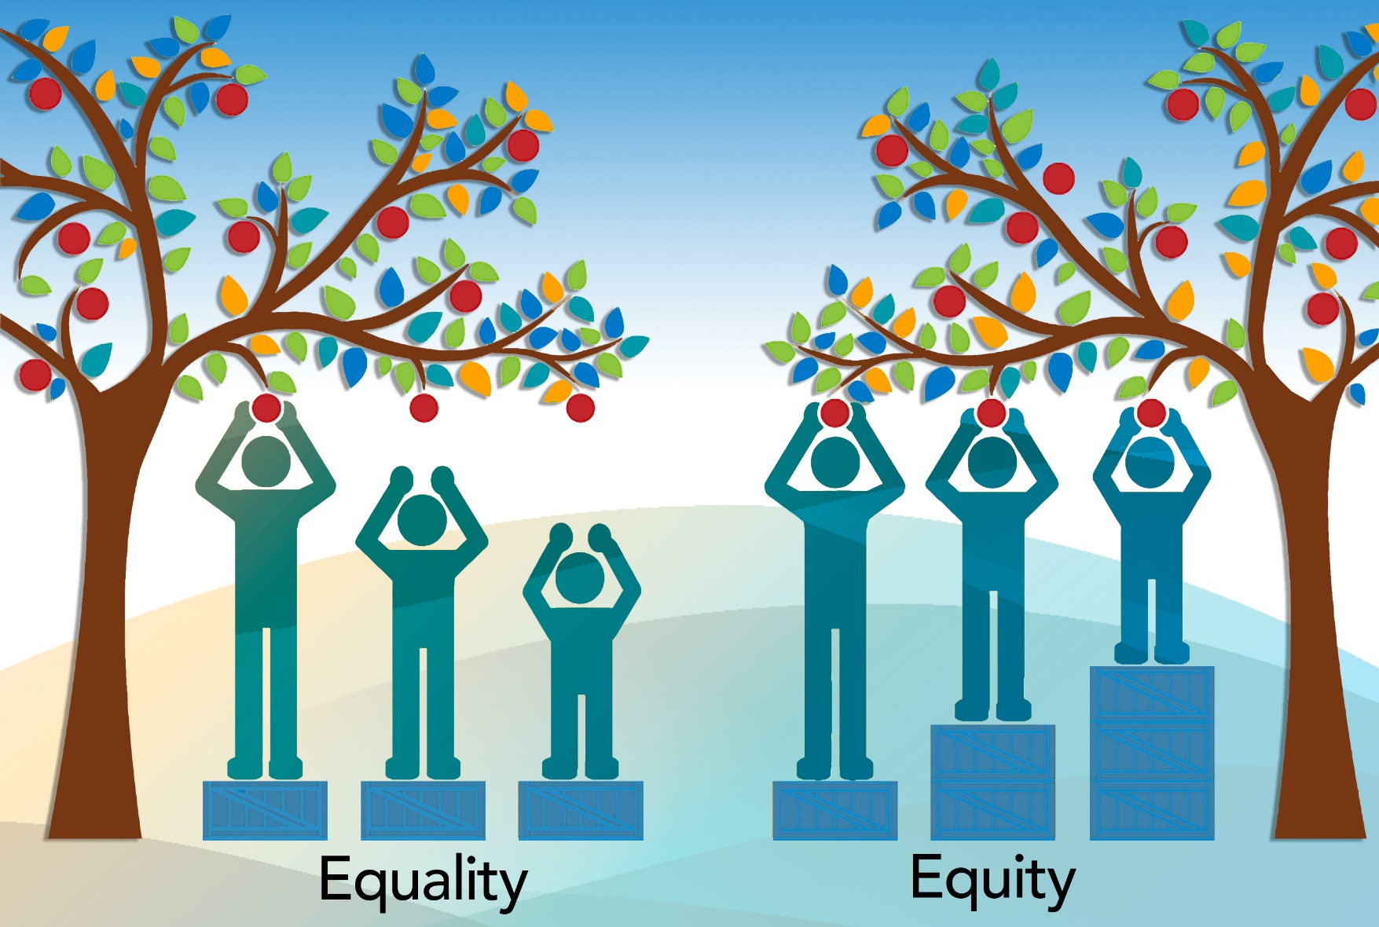
Notes:
This is an illustration similar to one that many of us have seen before, but is a good reminder of what we mean by equity.
Equity means ‘levelling the playing field’ by giving people what they need to achieve optimal health – which isn’t the same for every person. Equality is giving all people the same thing.

Slide 5
Education and health
Formal education rates are lower in our area when compared to the province
Lower life expectancy
Increased illness and injuries
Less knowledge of health behaviours
Increased need for social assistance
more involvement with the criminal and justice system
Notes:
lower levels of education often experience poorer
health outcomes, including reduced life expectancy
and higher rates of infant mortality.
Compared to Canadians who complete high school,
those who drop out are: more likely to receive social
assistance and unemployment payments; more likely
to become jailed; more prone to illness and injuries;
and more likely to have poor knowledge about health
behaviours.313 They are also less aware of and less apt
to use preventive health services and less likely to
participate (e.g. volunteer) in community activities.314
Illiteracy can have a direct impact on health, for
example, through the incorrect use of medications or
safety risks associated with the misuse of potentially
hazardous chemicals in the home or workplace.
Formal education rates are also lower in the area when compared to the
province: 76% of people aged 25-29 have completed high school compared with 91% provincially, and
54% of people aged 25-54 have post-secondary education compared with 67% provincially.

Slide 6
Ministry of Education
Students do better when they feel safe, supported and accepted
Rejection and exclusion lead to behavior problems and dropping out
Genuine parent/school partnership leads to better student achievement
Notes:
The Ministry of education in Ontario recognizes the link between education and health, and in 2009 released the equity and inclusive education strategy, which recognized three key concepts, based on evidence.

Slide 7
Ministry of Education requirements for boards
All publicly funded school boards are required to develop, implement, and monitor an equity and inclusive education policy that includes a religious accommodation guideline
All boards in our region have an equity and inclusive education policy
Notes:
From the 2009 document – 3 parts
Strategy
Policy – boards required to develop and implement an equity policy to be phased in and implemented fully by 2012

Slide 8
Framework
Notes:
To support boards in developing their policy, MEDU established this framework, which recognizes that the intersection of overlapping dimensions may create biases and barriers to student achievement, and supports government core priorities (reduce gaps in student acheivement, increase public confidence, etc.). Centre shows the guiding principals
The Ministry also embedded these principals of equity within other initiatives. For example the revised HPE curriculum.
All Boards are required to, and do have a Equity and Inclusive Education Policy – some are longer and some more to the point, but each follows this framework.
https://www.rrdsb.com/sites/www.rrdsb.com/files/brdadmin/policies/section2/2%2067%20Equity%20and%20Inclusive%20Education.pdf
http://www.tncdsb.on.ca/new/resources/PRO%20F10A%20Equity%20&%20Inclusive%20Education.pdf
http://www.kpdsb.on.ca/assets/uploads/board%20information/Policy%20NEW/503%20Equity%20and%20Inclusive%20Education.pdf
https://www.kcdsb.on.ca/leadership/Procedures/Documents/Equity%20and%20Inclusive%20Education.pdf
Boards are expected to:
Report progress to the community
Embed into all aspects of the board’s operations
Develop and moniter indicators to determine progress and identify areas for further work/improvement
Post the policy on their website

Slide 9
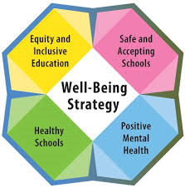
Promoting Well-Being – 2016
Contained 4 pillars – built on current initiatives
An engagement tool
Whole child approach
Recognizes well-being as an important factor in overall student success
NWHU can support work in all 4 pillars
Notes:
Building on equity and inclusive education, Ontario released a well-being strategy containing 4 key pillars: safe and accepting schools, positive mental health, healthy schools, and equity and inclusive education. Whole child approach – “it takes a village”. Meant as an engagement tool.
Building on Current Initiatives
Well-being has been long been recognized as an important factor in overall student success. Across the province much work has already been done, and continues every day, in pursuit of the goal of promoting well-being. This includes:
Promoting positive mental health is a key component of well-being. All school boards have a Mental Health Leader who develops and implements board-level mental health and addiction strategies and works with staff to build capacity to support positive mental health in the classroom for all learners and to support students with mental health needs or addictions.
Fostering safe and accepting schools sets out expectations for all school boards to provide safe, inclusive and accepting learning environments that support the achievement and well-being of every student, including addressing bullying, implementing progressive discipline and creating a positive school climate.
Developing healthy schools is key to establishing the learning conditions that are vital to help students reach their full potential by putting the conditions in place for students to adopt healthy active living practices and maintain them throughout their lives. All educators are expected to create a learning environment that will support not only students’ cognitive, emotional, social, and physical development but also their mental health, their resilience, and their overall state of well-being.
Supporting equity and inclusive education helps the education community identify and remove discriminatory biases and systemic barriers in order to support student achievement and well-being. Research confirms that students who feel welcome and accepted in their schools are more likely to succeed academically. In fact, everyone in our publicly funded education system – regardless of background or personal circumstances – should feel engaged and included.

Slide 10
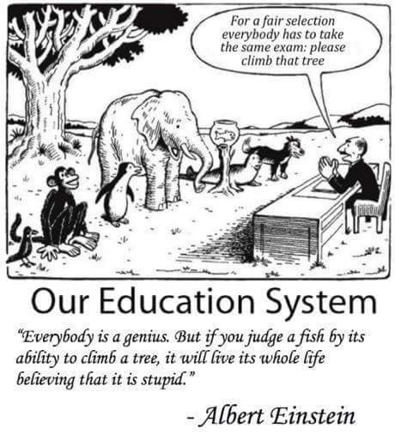
What does this mean for us and our work?
Notes:
What does all this mean for us and our work?

Slide 11
OPHS: School Health Standard
We are required to:
Collect data to monitor population inequities and provide that information to schools and boards, identify PH needs
Develop and implement a program of PH interventions informed by local assessments; identify school communities at risk for increased health inequities
Notes:
We need to utilize the data we have available with the SHAPES and COMPASS surveys, and our partnerships with school boards, to ensure we are equitable with our resources (financial and staff time).

Slide 12
Working with school boards
Continue to identify problems and barriers with equity (both health equity and educational equity) that schools and students are experiencing
Updating MOUs annually with boards that ensure NWHU and the school board partner on equity

Slide 13
NWHU Examples
Nutrition example – SNP, NFVP, Nutrition on Weekends
A few other examples:
Universal programs
Targeted programs
Dental screenings
PALs program
School based immunization clinics
Preventive and treatment services (HSO/MDO)
JumpStart
4 Directions community navigator
Notes:
We offer a variety of universal and targeted programs in schools. Using available data, working in partnership with boards, and completing health equity impact assessments on programs can help us continue to work towards health equity in the school setting.

Slide 14
Thank you!
Contact:
Stephanie Cran, Dryden Office
scran@nwhu.on.ca
Extension 302538
Notes:
If you have questions about the information in this presentation, please feel free to contact me.
Thank you for taking the time to listen to this equity and education presentation.

Slide 15
Notes:
End slide, to be viewed when closing your presentation.

